Slide 1
File Formats,Splitability & Compression

Slide 2
Based on below characteristics, different file formats has evolved
Faster read times
Faster write times
Splittable files (so you don’t need to read the whole file, just a part of it)
Schema evolution support (allowing you to change the fields in a dataset)
Advanced compression support (compress the files with a compression codec without sacrificing these features)

Slide 3
1.Text Input Format
2.Sequence File Format
3. AVRO
3.PARQUET
4.ORC

Slide 4
Text Input Format
Simplest Storage Format
Human Readable
It is only plain text where the fields are stored separated by a delimiter and each register is separated by a line.
SubTypes
JSON
XML
TSV
Advantages - Lightweight
DisAdvantages - Cant split compressed files

Slide 5
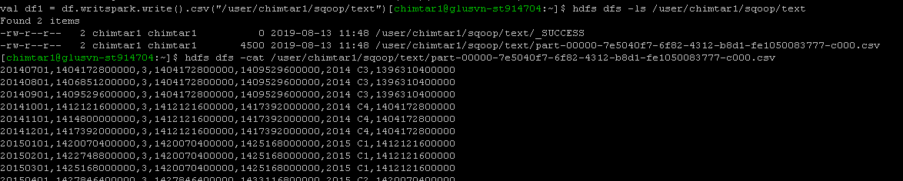

Slide 6
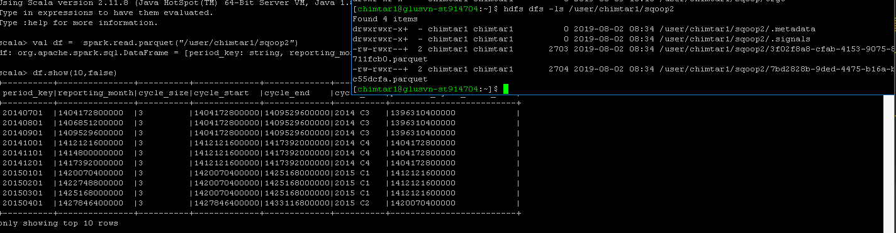

Slide 7
Sequence File Format
Internally used in Map Reduce Tasks
Its Flat serialized file key-value pairs
They encode a key and a value for each record
Records are stored in a binary format
Need to read and Decompress all the fields
SubTypes
Uncompressed
Record Compressed
Block Compressed
7. The compression types recommended in this format are:
Snappy
Gzip
Deflate
Bzip2
Advantages- Faster read/writes, solves small file problem,support block-level compression
Disadvantages- Not good for hive,Hive always stores entire line as a value

Slide 8
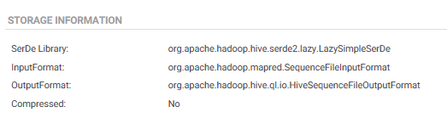
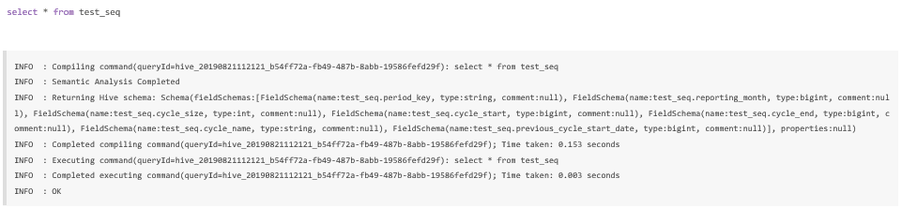
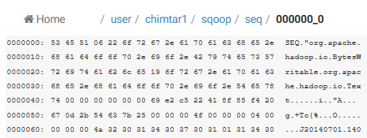

Slide 9
AVRO
language-neutral data serialization system
When Avro data is stored in a file, its schema is stored with it
schema evolutions
serialization/deserialization
supports block-level compression

Slide 10
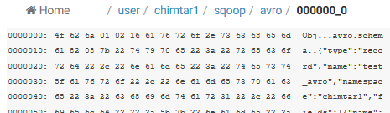
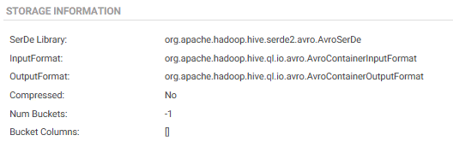

Slide 11
Columnar File Formats(Parquet,RC)
instead of just storing rows of data adjacent to one another you also store column values adjacent to each other.
So datasets are partitioned both horizontally and vertically.
This is particularly useful if your data processing framework just needs access to a subset of data that is stored on disk as it can access all values of a single column very quickly without reading whole records.
One huge benefit of columnar oriented file formats is that data in the same column tends to be compressed together which can yield some massive storage optimizations (as data in the same column tends to be similar)

Slide 12
PARQUET FILE FORMAT
columnar file storage.
Schema segregated into footer
Column major format with stripes
Simple type-model with logical types
All data pushed to leaves of the tree
Integrated compression and indexes
supports both File-Level Compression and Block-Level Compression
The compression types recommended in this format are:
Snappy (default)
Gzip

Slide 13
RC File Format
RCFILE stands of Record Columnar File which is another type of binary file format which offers high compression rate on the top of the rows used when we want to perform operations on multiple rows at a time.
RCFILEs are flat files consisting of binary key/value pairs,
RCFILE stores columns of a table in form of record in a columnar manner
It first partitions rows horizontally into row splits and then it vertically partitions each row split in a columnar way. RCFILE first stores the metadata of a row split, as the key part of a record, and all the data of a row split as the value part. This means that RCFILE encourages column oriented storage rather than row oriented storage. This column oriented storage is very useful while performing analytics.
columns stored separately
Read and decompressed only needed one.
Better compression
Columns stored as binary Blobs
Depend on Meta store to supply Data types
Large Blocks - 4MB default
Still search file for split boundary

Slide 14
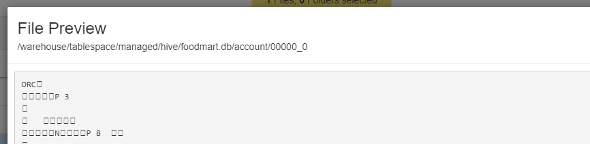
ORC (Optimized Row Columnar)Input Format
ORC reduces the size of the original data up to 75%. As a result the speed of data processing also increases and shows better performance than Text, Sequence and RC file formats. An ORC file contains rows data in groups called as Stripes along with a file footer.
ORC File Format Full Form is Optimized Row Columnar File Format.
Column stored separately
Knows Types - Uses Types specific en-coders
Stores statistics (Min,Max,Sum,Count)
Has Light weight Index
Skip over blocks of rows that that don’t matter
Larger Blocks - 256 MB by default, Has an index for block boundaries

Slide 15
Compression
File Level Compression
File-level compression means you compress entire files regardless of the file format, the same way you would compress a file in Linux. Some of these formats are splittable (e.g. bzip2, or LZO if indexed).
Block Level Compression
HDFS blocks are compressed separatey.Block-level compression is internal to the file format, so individual blocks of data within the file are compressed. This means that the file remains splittable even if you use a non-splittable compression codec like Snappy.
Benefits of Data Compressing
It saves a great deal of storage space.
It also speeds up the transfer of the blocks throughout the clusters.

Slide 16
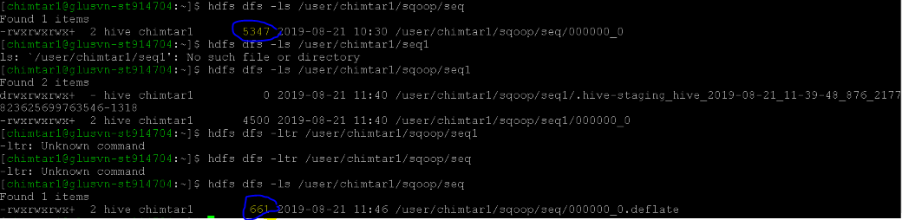
SET hive.exec.compress.output=true;
SET io.seqfile.compression.type=BLOCK;

Slide 17
GZIP
Provides High compression ratio.
Uses high CPU resources to compress and decompress data.
Good choice for Cold data which is infrequently accessed.
Compressed data is not splittable and hence not suitable for MapReduce jobs.

Slide 18
BZip
Provides High compression ratio (even higher than GZIP).
Takes long time to compress and decompress data.
Good choice for Cold data which is infrequently accessed.
Compressed data is splittable.
Even though the compressed data is splittable, it is generally not suited for MR jobs because of high compression/decompression time.

Slide 19
LZO
Provides Low compression ratio.
Very fast in compressing and decompressing data.
Compressed data is splittable if an appropriate indexing algorithm is used.
Best suited for MR jobs because of property (ii) and (iii).

Slide 20
Snappy
Provides average compression ratio.
Aimed at very fast compression and decompression time.
Compressed data is not splittable if used with normal file like .txt
Generally used to compress Container file formats like Avro and SequenceFile because the files inside a Compressed Container file can be split

Slide 21
https://nxtgen.com/hadoop-file-formats-when-and-what-to-use
http://www.diegocalvo.es/en/file-formats-big-data/
http://bigdata.black/infrastructure/storage/choose-data-format/
https://dzone.com/articles/apache-spark-performance-tuning-degree-of-parallel

